Slide 1

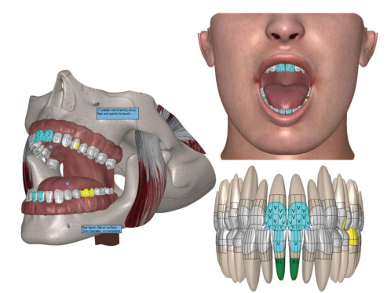
Training Guide
Note: This Training Guide does not substitute the User Guide
Please refer to your User Guide for step by step instructions

Slide 2


Contact Support
Refer to this training guide or Dental4Windows^{sql} User Guide for assistance.
The Support Department can provide you with Telephone and/or Remote connection assistance. Please refer to your Support Contract to confirm if this is available to your practice.
For further assistance, you can make contact via
eSupport: https://esupport.centaursoftware.com
Email: support@centaursoftware.com.au
Phone: (612) 9213 5000 Extension 2 or 1300 855 966
Weekdays 8:00am – 8:30pm (EST)
Saturdays 9:00am – 4:00pm for emergencies only (EST)
On Saturdays, our voicemail service is monitored every hour. To help us address your concern effectively, please leave a contact name, number, your Customer ID and a description of your issue.
For your convenience, note your Customer ID here: _______________________________________________
Contact Training
The Training department can assist with the following matters:
  Scheduling Training Sessions
  Cancelling Training Sessions
  Training Hours Used/Remaining
  Training Hours Expiry Date
  Quote for Extra Training Hours
Contact can be made via
Email: training@centaursoftware.com
Phone: (612) 9213 5000 Extension 3
Fax: (612) 9213 5098
Weekdays 8:30am – 5pm

Slide 3
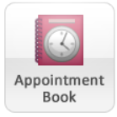

Appointment Book
How to navigate through the Appointment Book
Upper Right-Hand Side Arrows and Calendar
Add an appointment for an existing patient
Double click on the time slot > Search for patient > Enter details > OK
Add an appointment for a new patient
Double click on the time slot > Click Enter new patient tab > Enter details > OK
Edit appointment details
Double click on appointment or right click > Modify slot…
Send an appointment reminder for all tomorrow’s appointments
Options menu > Send Appointment Messages…
View SMS reply
Right click on the appointment > View SMS Reply
Mark an appointment as “Arrived”
Right click on Appointment > Arrived
How to cancel appointments and mark ‘Failed to Attend’
Double click on appointment > Select F in the Appointment Status
Add a break
Right click on the time slot > Insert New > Break > Enter details > Select Yes or No work time > OK
Cut/Copy/Paste/Delete Appointments and Breaks
Right click on the appointment/ break > Select action in menu
Setup Appointment status types
Options menu > Setup status types
Setup Appointment Classes
Options menu > Setup Appointment Classes, eg. Root Canal Treatment
Change Start and End time for one day
Right click on the day > Change Day/Book Setup
Navigate to Patient records
Right click on a patient appointment > Go to menu
Search for an appt
Find a vacant time
Standby List

Slide 4

Patient's tab
Add a new family head
Patient menu > Family head
Add a new family patient
Patient menu > Family member
Add a Patient Photo
Patient menu > Import Picture
Moving between fields
Press Tab key in your keyboard
Setup invoices to be sent to Veterans Affairs/Medicare
Address sub-tab > Send Invoice To: Other, Insurance, Veterans Affairs or Dental Benefit Scheme, CDBS
Setup Appointment and Recall Reminders to be sent via SMS
Address sub-tab > Send Appt reminders/ Recalls to > Select recipient > Click >Tick SMS
Enter Insurance details for a patient
Insurance/Various sub-tab > Click List > Click Add > Select Insurance Plan, Enter Member ID and Series Number > Exit
Enter Patient’s referred by Method
Recalls/Referrals sub-tab > Select Source > Select Category > Select Referred By
How to enter a ‘Referred To’
Recalls/Referrals sub-tab > Referred To sub-tab > Click > Enter Date and click Select a Specialist from list
Send a patient an SMS
Patient menu > Send SMS > Select Type or write a new message
Create a new Medical History entry
History sub-tab > Click > Enter new medical history
Create an alert
History sub-tab > Click > Select Alert Type > Enter alert notes > Select areas/actions to display alert > OK
Create a prescription
Find/View menu > Create prescription
See future appt
Find another patient
Flash icons to see letters, xRay, Allergies and Medical Conditions

Slide 5
Charting tab
Change a chart from Adult to Mixed Dentition
Charting menu > Show Mixed Chart > Click Yes to show all Deciduous to start with or No to show all Adult teeth
Create a new chart
Charting menu > New Charting
Marking a surface with a condition
Select the surface/tooth in current condition chart > Select the condition from toolbar/menu
Charting commonly used conditions and procedures
Use Toolbar icons; hover over to preview
Create a new chart and copy from previous chart
Charting menu > New Charting
Charting menu > Copy from Previous Charting: Select option
Mark multiple missing teeth
Condition's menu > Select option
View historic charts
Use date dropdown list
Turn on Treatment Plan in Charting tab
Find/View menu > Tick Show treatment plan
Indicate missing tooth
If a mistake was made, click to remove
Add notes to a tooth
Preview all notes > Press F6 keyboard
Complete List of Movements & Conditions

Slide 6
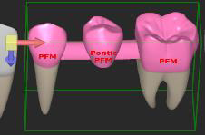
3D Charting tab
How to change the text colour of HINTS
Charting menu> Set Display Options > Hint text colour
or Location Setup > General tab > Group: Charting > Hint text colour
How to show tooth 36 in one tooth mode
Right click tooth 36 > One tooth mode
How to rotate a single tooth
Right click > Select tooth > Use the Rotation circle on the screen.
Right click > Select tooth > Use selected tooth rotation circle on screen
To create a Bridge right click on a tooth from left to right and select show connector
These options are made available when you right click on a tooth and/or bridge
Suggestion on how to call out the 3D Charting to the nurses

Slide 7
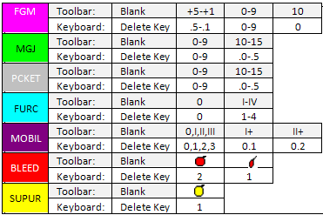
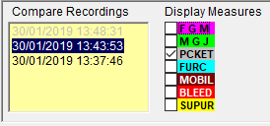
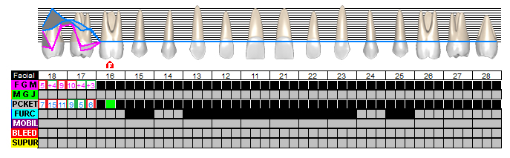
Perio tab
Set a tooth as missing
Select the Tooth area (cell) > Perio menu > Set Missing Tooth
Restore a missing tooth
Select where the tooth would be > Perio menu > Restore Missing Tooth
Change the sequence of Perio Charting
Perio menu > Select from 2 options in: Sequence of Perio Charting way round
View both the upper and lower jaw, then print
Select from Jaw drop list: All > Perio menu > Preview Screen > Print
FGM stands for
FREE GINGIVAL MARGIN
MGJ stands for
MUCO GINGIVAL JUNCTION
PCKET stands for
POCKET DEPTH
MOBIL stands for
MOBILITY
BLEED stands for
BLEEDING
SUPUR stands for
SUPPURATION
Compare recordings
Select previous chart > Tick Display Measures that you would like to compare
Red: Condition has become worse
Green: Condition has become better
Black: Nothing to compare
How to chart using keyboard

Slide 8


Treatment Plan tab
Organise a treatment plan in to visits
Click Order Visit > Highlight Item/s > Select Visit Number (repeat for all visits) click Order Visit when completed
Enter the total minutes needed for each visit
Enter the amount in the Min column for each visit – against first item in each visit
Print Treatment Plan with a personalized message
Treatment Plan menu > Preview Plan > Click Message > Highlight number of message > Click Select
Add notes to a Treatment Plan
Against an item click in the Nt column > Enter Notes > OK
Make a Treatment Plan inactive
Remove the tick from Active Treatment Plan checkbox
Process a Treatment Plan HICAPS quote
Treatment Plan menu > HICAPS Quote
Turn on the Case Presentation
Treatment Plan menu > Show Case Presentation
Add an Appointment and link a visit to the appointment
Make a patient appointment > Find Patient > Select Treatment Plan Visit within Appointment > OK
Treatment item and time will display in appointment
Review appointed date and time for treatment.
When Treatment plan is linked to the appointment, the appointment date and time will be shown in the appointed column
Create a new Treatment Plan
Hold Ctrl keyboard to select multiple items

Slide 9

Treatment tab
Transfer completed Treatment Plan Items to Treatment for billing
Treatment menu > Transfer from Treatment Plan > Highlight Items > OK
Write clinical notes against an item number
Against an item click in the Nt column > Enter Notes > OK
Create an invoice
Press F2 or click icon > Itemised Invoices menu > New Invoice Only
Submit an Insurance Claim
Press F2 > Click Hicaps/HEALTHPAY/HealthPoint
Create an Invoice without claiming & receive payment using EFTPOS e-payment
Press F3 > Enter Amount > Select Payment Type: EFTPOS e-payment
Create an Invoice with a 10% discount, no payment
When creating an invoice > Enter Discount By percentage (%) or By Amount ($)
Refund a paid Item number
Itemised Invoices menu > New Refund of Payments for Treatment > Highlight Items in background > Enter Details
Enter Lab Expenses with a payment date of the 18th of last month
Double click against an item in the Expenses column > Add > Select Expense Category and enter fee > OK
Create Payment Plan
Enter item > Itemised Invoices menu > New Invoice Only > Tick Show Extended Attributes > Enter Instalment Details
Preview all clinical notes
Treatment menu > Preview All Clinical Notes or press F6
Recalculate fees for items
Treatment menu > Recalculate ALL items fees based on current Fee Level
Transfer from Treatment Plan
Delete Treatment Item
Create an Invoice
Submit a claim
Create an Invoice & Receive Payment (No Claim)
Reprint Invoice

Slide 10
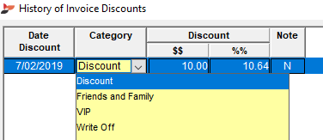
Invoice tab
Add notes to an invoice
Highlight Invoice > Double click in Instalment Notes
Reverse an Invoice (only if no receipt attached)
Highlight Invoice > Invoices menu > Reverse Invoice
Change the responsible party of an invoice
Double click in the Main RP column of Invoice
Modify invoice for payment plan
Highlight Invoice > Invoices menu > Edit invoice > Enter Installment Details
Print a list of all items, invoices and receipts for a period
Reports menu > Detailed Transaction Summary
Mark an invoice as Bad Debt
Highlight invoice > Click
Apply a discount on an invoice
Against an outstanding invoice > Click in the $Discount or %Discount section > Enter amount
Modify Discount Category
Double click in the Discount cell that is in line with invoice of interest > Select Category from dropdown list
Double click in Notes section to enter discount
Edit Invoice
Apply full discount
Indicate Bad Debt

Slide 11
Claim tab
Reverse a claim
Highlight Claim > Claims menu > Reverse Claim
Add notes to a claim
Double click in the Notes section of the Claim > Enter details
Reverse an electronic claim
Highlight the claim > Claims menu > Reverse Claim
Only allowable if there is no gap payment paid and added into D4W for the claim
Reprint a claim
Highlight Claim > Claims menu > Print Current Insurance Form
Review unprocessed claims
Claims menu > Check unprocessed claims
Preview a claim
Highlight claim > Claims menu > Preview Current Insurance Form
Edit a claim
Highlight claim > Claims menu > Edit details…
Reverse a claim
Preview a claim

Slide 12

Receipt tab
Pay off an outstanding balance using the EFTPOS e-payment
Receipts menu > New Receipt > Enter Amount > Select EFTPOS e-payment > press one of the buttons below depending on your electronic Claims System
Enter a deposit
Receipts menu > New Receipt > Enter Amount > Ensure it is not auto-allocated to an outstanding amount
If there is an amount outstanding and you wish to enter a deposit, remove the tick from Auto allocate Payments checkbox
When there is no amount outstanding, payments will be entered as a deposit amount
Refund a deposit
Receipts menu > New Refund
Change the payment method of an unbanked payment (e.g. EFTPOS to Cash) without deleting
Highlight Receipt/Payment > Change the Type in Details of Receipt
Reverse an EFTPOS e-payment
Highlight Receipt > Receipts menu > Reverse Receipt > press the Reverse button (follow prompts)
Place a payment on hold from banking whilst in Receipts
Highlight Receipt/Payment > Click in the On Hold column and a H will appear
Process a bounced payment (e.g. Cheque bounced)
Highlight Receipt/Payment (must be banked) > Right Click on the Type > Bounce Payment
Print a list of all items, invoices and receipts for a period
Reports menu > Detailed Transaction Summary
Preview Receipts

Slide 13
Letters tab
Add a new Category (e.g. Referral Letters)
Templates menu > Add New Category
Add new Template (e.g. Perio Referral)
Highlight the Category to add to > Templates menu > Create Template
Use input fields on a template
While template is open > Add Ins > InsertD4W (MS Word Link)
While template is open > Insert > Input Field (SIMPLE RTF Editor)
Insert a patient’s chart into a letter
In correct Patient > double click on template > Add Ins > InsertD4W > Charting/Perio (MS Word Link)
In correct Patient > double click on template > Insert > Charting/Perio (SIMPLE RTF Editor)
Rename a template
Highlight Template > Template menu > Rename Template
Rename a category
Highlight Category > Template menu > Rename Category
Modify an existing template
Highlight Template > Template menu > Modify Template
Delete an unused template
Highlight Template > Template menu > Delete Template
Mark Template as Medical History Form
Highlight Template > Template menu > Mark as Medical History Form
Medical History Form can be printed straight from Appointment Book: Right Click Appointment > Print > Medical History
To open a letter and use it for a patient, double click on the template in the right panel
Input fields should be used on a letter Template to help save you time by picking up the details from the patients file rather then you typing it in.

Slide 14
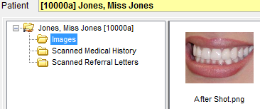
Documents Manager tab
Create a new folder (E.g. Scanned Referral Letters)
Documents menu > Create New Folder > Enter Name of Folder > OK
Add files to a folder (copy or move)
Highlight Folder > Document menu > Add Files > Copy/Move to Folders > Find File > Open
Scan documents directly to the folder
Highlight Folder > Document menu > Capture from Scanner > Scan
Delete a file from a folder
Highlight Folder > Highlight File > Document menu > Delete File/Folder
View a file
Highlight Folder > Double Click on File
What are the different views of Document Manager?
In Documents Manager Tab In Charting tab
Drag a document from Desktop into Documents Manager
Highlight the document > left click and drag > release > select Copy or Move to save document
Create a new folder
Copy or Move Folder
Copy or Move File

Slide 15
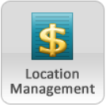
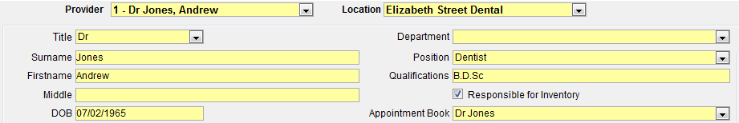
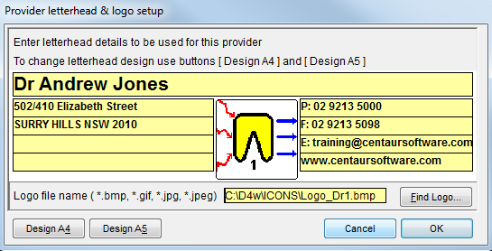
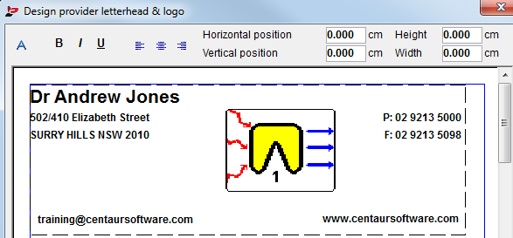
Provider / Staff tabs
Add a new provider
Provider tab > Operations menu > New Record > Enter Details
Provider ID & Merchant ID must be entered for electronic claims to work and for the number to show on Invoices & Receipts
Setup a provider with 45% commission
Select the Provider > Click on the Commission Notepad Enter Start Date > Enter Commission
Link an appointment book to a provider
Select the Provider > Select from the Appointment Book drop list for relevant Provider
Setup a provider’s individual letterhead & logo
Select the Provider > Press the Letterhead & Logo Setup button > select either: Design A4 or A5
Location Setup > General tab > Accounting: Invoices & Receipts > Letter Head type of Invoice/Receipt printout = Provider Letter Head
Add a new staff member
Staff tab > Operation menu > New Record > Enter Details
Make a staff member inactive
Select the Staff Member > Remove the tick from Is Active
Before adding a new Provider, setup their Appt Book first so you can easily link them
Bank redirections must be setup once a new Provider is added
Hygienists must be setup as a Provider, not Staff member
For report purposes, DO NOT share appointment books between providers

Slide 16
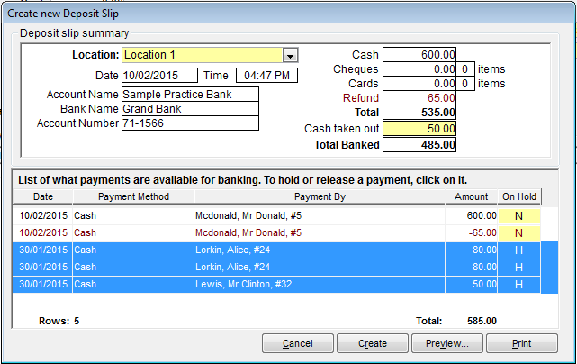
Bank Slip tab
Print cash & cheques bank slip
Bank Slip menu > New Slip > Print
Print EFTPOS bank slip
Bank Slip menu > New EFTPOS > Print
Print Health Insurance claims bank slip
Select Bank Account set for Insurance claims > Bank Slip menu > New EFTPOS > Print
Re- print a bank slip
Select the bank slip from the Deposit Slip ID to view list > Reports menu > Print Full Details of this deposit
Refund: When there is a Refund for Treatment or a Refund for a Deposit it will show here
Cash taken out: Used when taking cash from banking, enter the amount into “Cash taken out’
On hold: Use the On Hold if a payment is not to be included in a Bank Slip until later
Before printing Bank Slips, check totals by using the icon (Total Receipts Report)
The deposit slip for Cash and Cheques (New Slip) can be used to deposit money at the bank

Slide 17
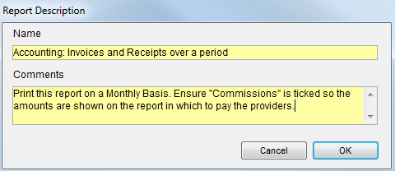
Reports tab
Setup a group of “Commonly Used Reports”
Operations menu > Set Report Groups > Add > Select the group against the reports
Report that shows Invoices, Receipts, Expenses, Commission and Discounts
Accounting: Invoices and Receipts over a period
Print a list of all items that were performed over a period
a) Items Performance
b) Items Performed on Patients
c) Items Performed over a Period
Staff Clock on & Clock off and the report based on their working hours
Clock On/Off: Anywhere in the program, Go To menu > Staff Clock On / Staff Clock Off > enter Username and Password
Report: Staff Attendance Times
Report that shows the $ value based on referrals
Efficiency of Referral Sources (Financial Details)
Report for all discounts with a category “Fund Only” (only if using)
Discount Categories Report > Select Fund Only in report parameters
Report that shows “Patients without any clinical notes in a day”
Items Performance over a Period > tick checkbox Show patients without any clinical notes in a day
Right click on a report to edit the Description of a report – this may have some hint/tips for staff to understand when and why the report should be run. DO NOT CHANGE THE NAME OF THE REPORT.
The comments entered will show in the “comments” section at the bottom of the page when the report is highlighted.
Commonly used reports for end of day:
Total Receipts
Accounting: Invoices and Receipts over a period
Unprinted Invoices
Items performed over a period (patients without any clinical notes in a day)
Discuss with your trainer the best reports to run for your practice

Slide 18
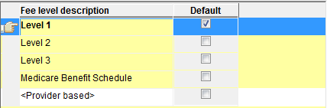
Fees tab
Add a new fee level
Click New Level button > Enter the Name > OK
Print Veterans Affairs fees
Operations menu > Fee Levels Report > Highlight Fee Level > OK
For Standard Fees, set all crown item numbers to be Mode: Increase
Highlight Standard fee level > Against all crown item numbers in the Mode column, change to Increase
Explain each of the Modes available to select from
Variable – Within Treatment Plan and Treatment, the Fee can be increased or decreased
Fixed – Within Treatment Plan and Treatment, the Fee cannot be altered
Increase – Within Treatment Plan and Treatment, the Fee can be increased only
Decrease – Within Treatment Plan and Treatment, the Fee can be decreased only
See a fee level as default level
Highlight a fee level > Click Set as default level button
Copy fees to another location (for multi-location practice)
Highlight a fee level > Click Copy Fees to Location(s) button > Select the period to be copied from, and the location this fee level to be copied to > Click Update button
Update/Inactivate fee levels
Highlight the Fee Level > Create a new start date > Click Update the Fees button > Select Increase fees > Enter amount > tick Update all Fees > OK
When updating fees, you have the option to enter the fee manually, or increase/decrease by a %.
Within “Update Fees” you can update all fees at once or only fees between certain $ amount ($50.00 - $150.00) and have the option to round to the nearest 0.05c – 1.00
You can make a fee level inactive and move patients to another fee level
The hand refers to the Fee Level you are viewing on the right of screen
The default tick signifies that when a new patient is entered, this is the level they will be assigned
Provider based fees are used when multiple providers wish to charge different amounts for the same items and patients

Slide 19
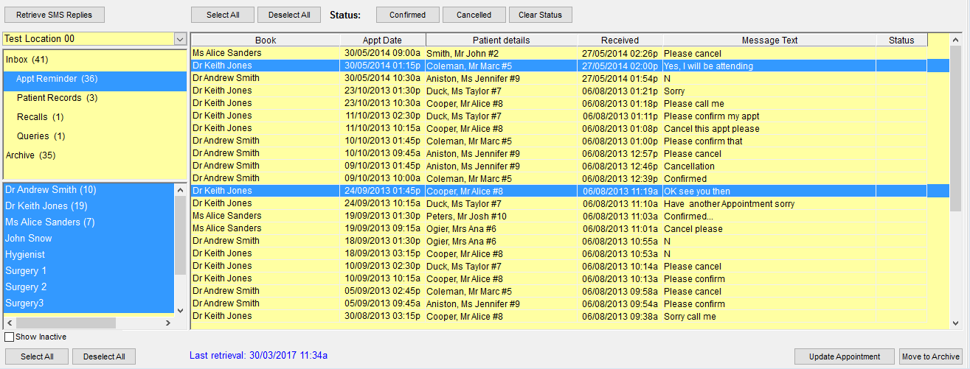
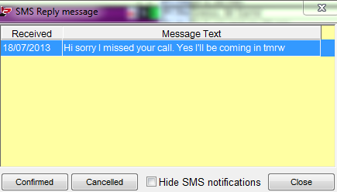
SMS Manager tab
Update the Appointment Book from the SMS Manager tab
Select the Appt Reminder inbox > Select the appointment book > Select the replies to be updated > Select the Status: Confirmed or Cancelled > Click on Update Appointment
See and update the SMS reply message from the Appointment Book
Right Click on the appointment > View SMS Reply
Option to move messages to Archive after Auto-Updating appointment status
Location Setup > General tab > Group: SMS Settings > Move Replies to Archive after Auto-Updating appointment status > Select one of the options
Messages that update the appointment status will automatically go into Archive
Manage all SMS replies from one place

Slide 20
Automation tab
Turn on Automation
Location setup > General tab > Group=Automation > Turn on Automation=Yes
D4W needs to be restarted afterwards
Appointment’s tab
Setup Daily Appointment Reminders
  Select the Appt Reminder type, e.g. Monday appts
  Set/ Type sub-tab:
  Select Appt book
  Include/exclude status if relevant
  If sending Prebooked Recall reminders, tick ‘Update the Appointment’, select the status representing SMS sent; tick ‘overwriting status’, select status representing prebooked reminder sent
  Reminders sub-tab:
  Setup the reminder templates for those you will use by clicking on the edit button
  Select order of communication method e.g. 1- SMS, 2- E-mail, 3- Phone call
  Schedule sub-tab:
  Set the frequency for the reminder to be sent
  Set the timing the batch to be run
  Set the parameters for the reminder to pick up, confirm this setting is correct by clicking Check Upcoming Run Dates button
  Tick Enable
Setup Prebooked Recall Reminders
  Select the Appt Reminder type
  Set/ Type sub-tab:
  Select Appt book
  Include status for Recall appointments, select exclude status if relevant
  Tick Update the Appointment, select the status representing prebooked reminder sent
  Reminders sub-tab:
  Setup the reminder templates for those you will use by clicking on the edit button
  Select order of communication method eg. 1- SMS, 2- E-mail, 3- Phone call
  Schedule sub-tab:
  Set the frequency for the reminder to be sent
  Set the timing the batch to be run
  Set the parameters for the reminder to pick up, confirm this setting is correct by clicking Check Upcoming Run Dates button
  Tick Enable
Recalls’ tab
Please contact Centaur Support and book a time to discuss and setup recall automation.
Queries’ tab
Commonly used automated queries are Birthdays and Patient Reactivation.
Please contact Support for assistance, or the Training department to schedule a training session.
Before setting up Recalls and Queries automation, please contact Centaur for a consultation.
Next page

Slide 21
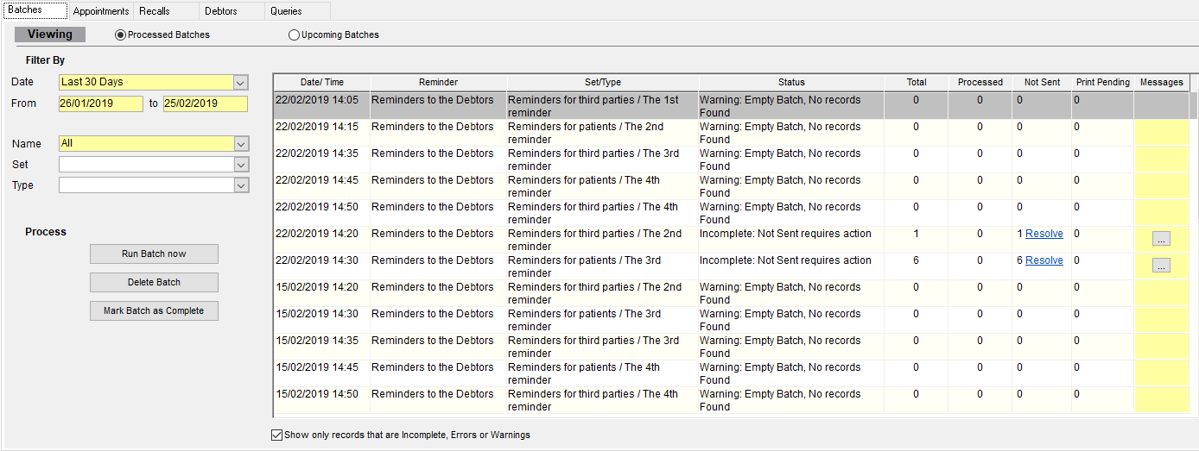
Debtors tab
Setup each Debtor Reminder
  Select the Debtors Reminder type
  Set/ Type sub-tab: You are able to modify set/type names and reminder period
  Reminders sub-tab:
  Setup the reminder templates for those you will use by clicking on the edit button
  Select order of communication method e.g. 1- SMS, 2- E-mail, 3- Phone call
  Schedule sub-tab:
  Set the frequency for the reminder to be sent
  Set the timing the batch to be run
  Parameter is set by the system and cannot be modified
  Tick Enable
If SMS or Email is selected in Reminders sub-tab, and templates are setup, when the type is enabled, reminder will be sent automatically to patients whose ‘Send Invoice to’ method is set to be SMS/Email.
Please make sure all outstanding invoices are followed up promptly to avoid incorrect communication with patients.
You can’t add/delete Debtors Sets/Types
Check incomplete batches
Processed Batches > Tick Show only records that are Incomplete, Errors or Warnings
Find patients that didn’t receive reminders
Processed Batches > Highlight an incomplete batch with a number in Not Sent column > Click Resolve
Run a batch after correcting errors
Processed Batches > Highlight the batch > Click Run Batch now > Click Yes to message
Next page

Slide 22
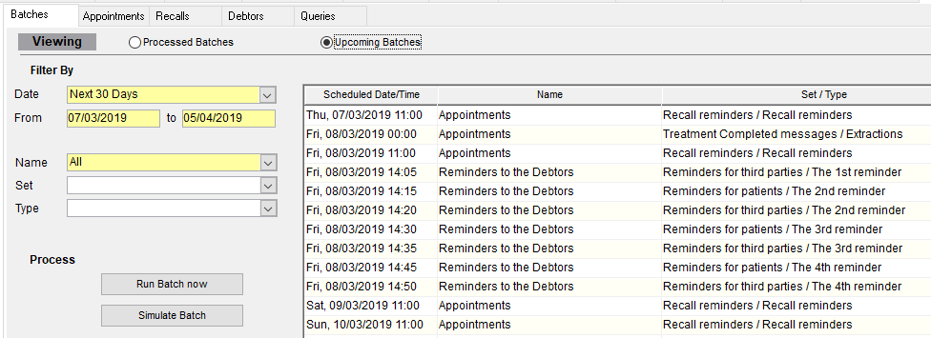
Delete an empty batch
Processed Batches > Highlight the batch > Click Delete Batch
View Upcoming Batches
Location Management > Automation tab > Batches tab > Upcoming Batches
Process a batch before scheduled run date
Upcoming Batches > Highlight the batch > Click Run Batch now
Simulate a batch
Upcoming Batches > Highlight the batch > Click Simulate Batch > Click Yes to message
Filter batches by date
Batches tab > Select from Date drop list or enter date range
Filter batches by name
Batches tab > Select batch name from Name drop list

Slide 23

Mail Merge Setup tab
Edit the standard recall letter
Mail Merge Category: Recalls > Highlight the recall type > Click the edit icon for Letters/Email Templates
Change the reminder periods for ‘Reminders to the Debtors’
Mail Merge Category: Reminders to the Debtors > Highlight the Reminder type > Edit value in Reminder Period Days
Modify the ‘Simple Query Wizard’ template
Mail Merge Category: Queries > Highlight Simple Query Wizard > Click the edit icon for Letters/Email Templates
Modify the ‘Query by date and Procedures’ SMS template
Mail Merge Category: Queries > Highlight Query by Date and Procedures > Click the edit icon for Letters/Email Templates
Create an appointment confirmation SMS template
Mail Merge Category: Appointments > Add a new Set and Type > Click the edit icon for SMS Template > Create Template > Save
Click the add new icon > Highlight the Providers the SMS Template is used for
Create a patient SMS (E.g. Please bring in your OPG) template
Mail Merge Category: Patients > Add a new Set and Type > Click the edit icon for SMS Template > Create Template > Save
Mail Merge Category: Recalls
The items entered in “Recall Trigger Items” are those you wish to trigger an update of the recall date.
E.g. Whenever one of these items is entered in treatment, and an invoice/receipt is generated, you have
two options:
• Update recall date box appears, and you click OK to update recall date.
• Update recall date box doesn’t show, but update recall date automatically. You need to turn on this setting:
Location Setup > General tab> Accounting: Invoices & Receipts > Method of updating Recall Date at the end of creating invoice = Automatic

Slide 24
Mail Merge Category: Appointments
Here you can setup Appointment Reminder Templates. They can be setup for individual or all providers.
E.g. Dr John Smith would like a different Appointment Reminder sent to his Patients than Dr Jones.
NOTE: Ensure this setting is turned on in order for templates to work:
Location Setup > General tab > Group: Appointments > Use Templates for SMS = YES
Mail Merge Category: Patients
You can setup Patient SMS Templates. They can be setup for individual or all locations.
E.g. The practice would like to send an SMS to patients with OPG taken in an Image Centre.
To edit a template, highlight the template and click on the icon
Setup common SMS templates in Mail Merge to send to patients
Setup appointment SMS confirmation templates in Mail Merge per provider
Discuss with your Trainer how you would like to send your recalls so the letters can be setup correctly

Slide 25
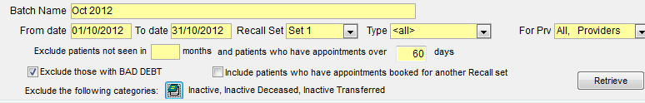
Recalls tab
The following instructions are for manual Recalls. Our recommendation is to setup Automated Recalls
Write your own instructions on how to do the following
Batch name:
----------------------------------------------------------------------------------------------------------------------------------------------------------
Providers:
----------------------------------------------------------------------------------------------------------------------------------------------------------
Date Range:
----------------------------------------------------------------------------------------------------------------------------------------------------------
Exclude:
----------------------------------------------------------------------------------------------------------------------------------------------------------
Include Appts:
----------------------------------------------------------------------------------------------------------------------------------------------------------
Deselect:
----------------------------------------------------------------------------------------------------------------------------------------------------------
Update Dates:
----------------------------------------------------------------------------------------------------------------------------------------------------------
Update Types:
----------------------------------------------------------------------------------------------------------------------------------------------------------
Update Period:
----------------------------------------------------------------------------------------------------------------------------------------------------------
Print/Send:
----------------------------------------------------------------------------------------------------------------------------------------------------------
Note: Centaur recommends that all clients setup their recalls through our Automation feature.
Discuss with your Trainer how you would like your recalls to be sent
Send 1x Letter
Send Multiple Letters over a period of time
Find out the Patients that didn’t respond (lapsed) etc.
Recall Letters and SMS templates are setup in ‘Mail Merge Setup’

Slide 26
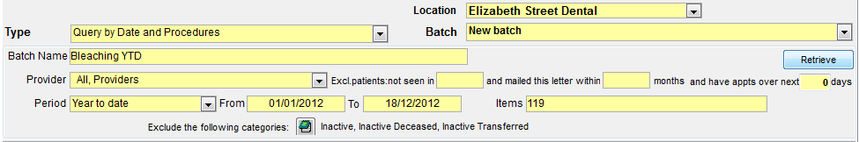
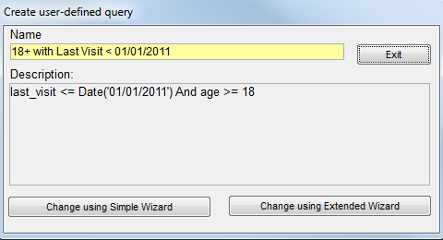
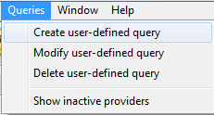
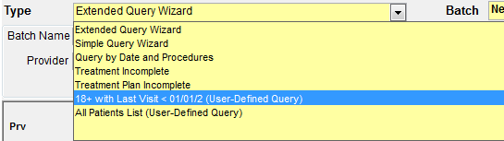
Queries tab
Generate a list of all patients with a last visit greater than the 01/01/2012
Type: Simple Query Wizard > Enter Batch Name > Select Provider/s > Retrieve
Column: Last Visit, Operator: Greater Than Value: 01/01/2012
Generate a list of all patients with an incomplete treatment plan
Type: Treatment Plan Incomplete > Enter Batch Name > Select Provider/s > Select Dates > Retrieve
Generate a list of all patients that have had a 615 in the year to date
Type: Query by Date and Procedures > Enter Batch Name > Select Providers > Enter Period > Enter Item > Retrieve
The below query is based on all patients that have had the item 119 entered in treatment for the year to date (YTD)
Create “User-Defined Query” for batches you will generate on a regular basis.
The query you create will be saved under “Type”.
Letters and SMS Templates for Queries are setup in ‘Mail Merge Setup’
Great for sending promotions, newsletters and group letters to patients
Follow up patients with outstanding treatment plans

Slide 27
Debtors tab
Print reminder letters for all invoices over 30 days
View: Over 30 Days > Highlight > Due for Rem1 > Print/Send: Reminder 1
Print a list of all outstanding invoices
View: All Issued > Highlight: All > Print/Send: Print List > Print
View a list of all bad debts
View: Bad Debt Only
Write notes against an outstanding invoice
Against the Invoice click in the Notes column > Enter Notes > OK
Each time a Reminder Letter is sent to a patient, the date will appear in the relevant reminder period (e.g. 14-21 Days).
Write notes against an invoice when arrangements have been made with a patient.
Right Click on a patient’s invoice to easily navigate from Debtors to an area of their Patient Details.
To mark an Invoice as a Bad Debt, use the icon
Put all Third Party (e.g. Veterans Affairs) outstanding invoices on HOLD to stop reminder letters being printed
Notes entered against an Invoice will show here and in the patient’s Invoices tab

Slide 28

Insurances / Third Parties tabs
Insurance
Add a new Insurance Company and Plan
Operations menu > New Record > Enter Details (Name, Abbreviation and E-System required) > in the Insurance Plans section click Add > Enter Details of the Plan
Ensure all Insurance Companies and plans that work with your terminal have the E-System, Card No Prefix and Limit of Items per Claim setup.
Print a list of all the Insurance Prefixes
Operations menu > Show HICAPS Ins Prefixes > Print
Third Party
Add a new Third Party from Insurance Module
Insurance module > Third Parties tab > Operations menu > New Record > Enter Details
Add a new Third Party from Patient Records
Patients Records > Patient tab > Find/View menu > Third Parties List > Add New > Enter Details
Third Parties can be assigned as the responsible party of patient’s invoices
The list of Insurances is updated by Centaur when we know of a new company. If you come across a company not setup in the database, you will need to add it.
Third Parties can be setup in Insurance or Patient Records
DVA Online Claims can be processed in this module. Please make sure you have the component needed from Medicare than contact Centaur Support.

Slide 29
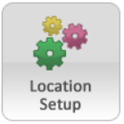
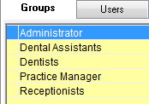
Security tab
Setup a Username and Password for a User
Security tab > Users sub-tab > Double click on the user’s name > Enter Details
Edit a Password without entering Security
Go to an area of the program that is password protected > Enter your username and password > Click > Enter new Password
Add a new Security Group (E.g. Dentists)
Security tab > Groups sub-tab > Record menu > New Record > Enter Details
Setup where you would like to restrict access (Setup Security)
Record menu > Security Status > Place a tick against each action/mode you would like to restrict access to
Looking at the “Modes/Actions” (right of screen when user is highlighted on the left) what do the following represent
User and/or Group has full access, a password will not be asked
User and/or Group has full access, a password will be asked and access will be granted
User and/or Group has no access, a password will be asked and access will be denied
Setup multiple groups to suit the different employees/users at your practice.
Preset security access for each group, then assign new staff to the group.
A tick against a mode/action in “Setup Security” means a username/password will need to be entered to complete the mode/action, or enter that area of the
program.
To setup a Username & Password, double click on the individual’s name
When a staff member is made inactive, their security access is removed
Only the Practice Owner should have full access to the system

Slide 30
Postcode / Allergy/Med tabs
Postcodes
Add new Suburb in NSW
Highlight NSW in the “States” list > Click Add at the bottom of the “Suburbs” list > Enter Details
Allergy/Medical Conditions
Edit the spelling of an existing Medical Condition
Type over the top of the current word in the “Medical Condition” list
Add a new allergy in “Allergy/Med” tab
Click Add button in the “List of Allergies” > Enter Details
Add a new allergy in Patients tab
Patients tab > History sub-tab > Click Add button relative to the allergies list
Merge an incorrect Medical Condition/Allergy to another one
Highlight the incorrect Medical Condition/Allergy > Click Merge > Select the correct one > OK

Slide 31
Fast Notes tab
Add a new Fast Notes Group
Record menu > Edit Notes Groups > Add > Enter Details
Add a note to the new Fast Notes Group
Select the new group from Notes Group drop list > Click Add button > Enter Details
Arrange the notes within the same group
Highlight the note you wish to move > Click the arrow button to move the note up or down
Example of commonly used fast notes group – Hygiene group, RCT group, Surgical group, etc.
Use ‘Enter’ to write notes in multiple lines
Add commonly prescribed medication into the Medication List Fast Notes Group for easy access when creating prescription

Slide 32
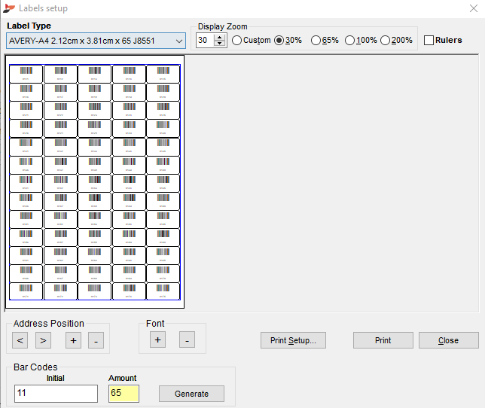
Sterilisation tab (Optional module)
Setup “Pack Contents”
Location Setup > System Tables tab > Sterilisation Pack Contents List > Add
Generate and print labels
Location Management > Sterilisation tab > Autoclave menu > Generate & Print Labels > Select correct Label Type > Enter amount of labels to be printed per page > Click Generate > Adjust barcode position if needed > Print
Add a new autoclave cycle
Sterilisation tab > Click Add from the Autoclave Cycles section > Enter Details and Scan or manually add packs
Add a pack against a patient
Treatment tab > Enter “STERI” item number > Click in Notes column > Scan or manually add pack/s against patient
Run a report of packs used on patients
Sterilisation tab > Highlight Cycle to report on > Report menu > Autoclave Cycle – Packs used on Patients
An item number named “Steri” is preset in the database for you to log sterilization records in Treatment details
Place barcodes on the packs after the cycle to avoid smudging of the ink

Slide 33
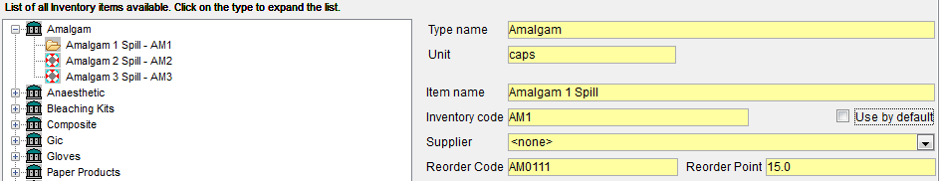
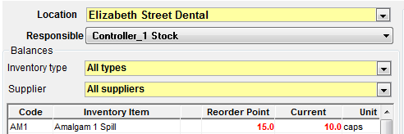
Inventory /Stock Control tabs
(optional module)
Inventory
Inventory: Add a new supplier
Inventory tab > Record menu > Suppliers List > Add
Inventory: Add a new inventory item
Inventory tab > Open Inventory Type (e.g. Amalgam) > Click Inventory Item button > Enter Details
Inventory: Make an inventory item obsolete
Inventory tab > Highlight the Item > tick Obsolete
Inventory: Print a list of all inventory items
Inventory tab > Record menu > Inventory List > Print
Stock Control
Stock Control: Create a stock order
Stock Control tab > Operations menu > New Record > Select Transaction Type: Order Inventory Items > OK
Highlight Items (left of screen) to order > Press the right pointing arrow > Enter the QTY to order > Press Accept
Stock Control: Input inventory items
Stock Control tab > Operations menu > New Record > Select Transaction Type: Input Inventory Items > OK
Highlight Items (left of screen) to input > Press the right pointing arrow > Enter the QTY to input > Press Accept
Stock Control: Output inventory items
Stock Control tab > Operations menu > New Record > Select Transaction Type: Output Inventory Items > OK
Highlight Items (left of screen) to output > Press the right pointing arrow > Enter the QTY to output > Press Accept
Enter a ‘Reorder Point to help easily identify
when stock needs to be ordered.
Complete a stock take prior to adding current stock levels
Only one username/password should be used to access Stock Control – we suggest you setup a staff member ‘Stock Control’
Discuss with your trainer or support analyst how you would like to keep track of used stock
  Have staff write down when they take/use
  Link stock to treatment items so they are deducted when an item is performed (note: this is not ideal for all stock items)

Slide 34
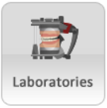
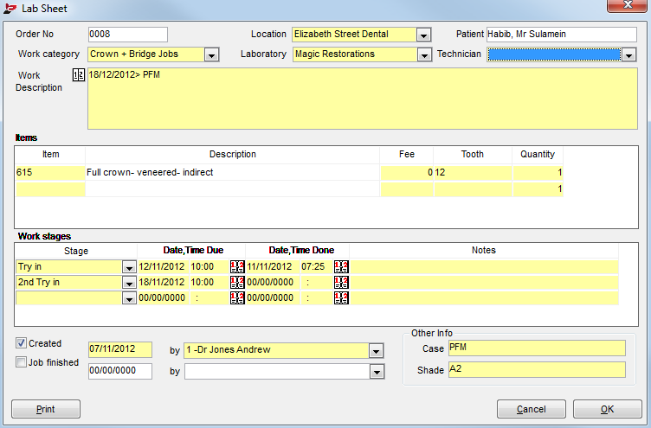
Laboratories (Optional module)
Add a new laboratory (in-house)
Laboratories tab > Record menu > New Record > Enter Details > Tick In-house checkbox
Add a staff member to a laboratory
Lab Staff tab > Select Lab from Laboratory drop list > Operations menu > New Record > Enter Details
Add a fee level for a laboratory
Fees tab (within Laboratories Module) > Select Lab from Laboratory drop list > Click New Level > Enter Details
Add a Lab job to a patient’s treatment
In Treatment tab, against and item number, click in the L column (lab sheet will appear) > Enter Details > OK
View all incomplete lab jobs for a laboratory
Lab Jobs tab > Select Lab from Laboratory drop list > Select Incomplete from Work Stage drop list
Run a report of all lab jobs by due date
Lab Jobs tab > Orders menu > Select Lab Jobs by Date Due Report
Delete a lab job from a Patient’s file
Patient Records > Treatment tab > Lab Jobs menu > Select Lab Jobs List > Highlight Job > Click Delete
In the ‘Lab Jobs’ tab, what do the following colours represent
Pink: Overdue
Green: Due today, but after current time
Blue: Due within the next 24hrs
White: Not due yet
Grey: Finished
Click on the “Next Appointment” icon when entering a Lab Sheet to see when the patient is next booked in.
The same lab sheet may be used for each work stage.
Setup an ‘In-House Lab’ to track Bleaching Trays, Mouthguards etc.
Form ‘D’ represents the lab slip used for Dentures
Form ‘C&B’ represents the lab slip used for Crowns and Bridges
Ability to draw on the Lab sheet

Slide 35
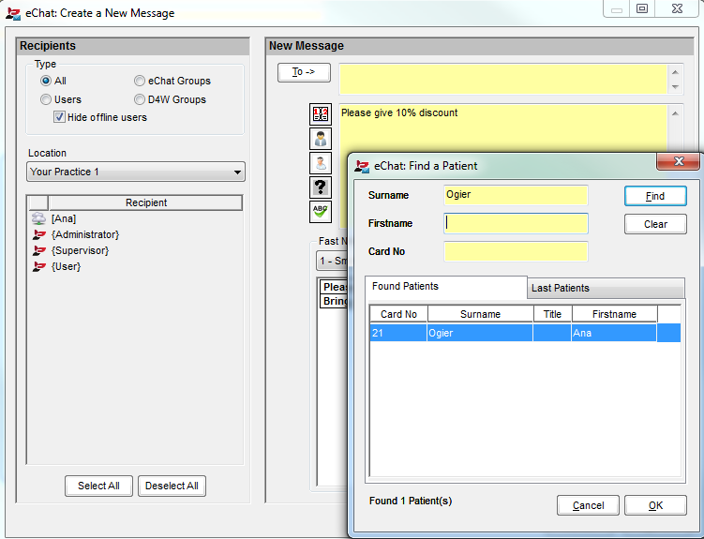
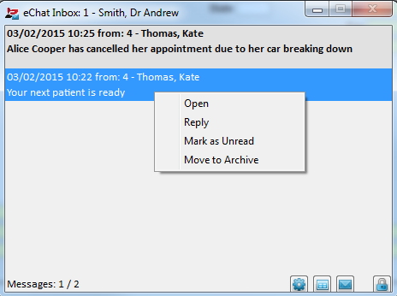
eChat
How to log on the eChat
Click on eChat >Enter Username and Password
How to create and send a New Message
Open the eChat inbox window > Click on the new message icon Select Recipient > Type in message > Press Send
How to View/Reply to a message
Double left click on message
How to create eChat groups
Click on Settings > Groups > Add
How to create eChat Fast Notes
Location Setup > Fast Notes tab > Notes Group = eChat > Add
Alt N = Create a new message
Alt S = Send
Click on icon to search for a patient
Reply to a message by Right Clicking on the received message

